Slide 1
ECDSA P-256 support in DNSSEC-validating Resolvers
Geoff Huston, George Michaelson
APNIC Labs, May 2015

Slide 2
ECDSA
Elliptic Curve Cryptography allows for the construction of “strong” public/private key pairs with key lengths that are far shorter than equivalent strength keys using RSA
  “256-bit ECC public key should provide comparable security to a 3072-bit RSA public key” *
And the DNS protocol has some sensitivities over size when using UDP
  UDP fragmentation has its issues in both V4 and V6
* http://en.wikipedia.org/wiki/Elliptic_curve_cryptography

Slide 3
ECDSA vs RSS
$ dig +dnssec u5221730329.s1425859199.i5075.vcf100.5a593.y.dotnxdomain.net
; <<>> DiG 9.9.6-P1 <<>> +dnssec u5221730329.s1425859199.i5075.vcf100.5a593.y.dotnxdomain.net
;; global options: +cmd
;; Got answer:
;; ->>HEADER<<- opcode: QUERY, status: NOERROR, id: 61126
;; flags: qr rd ra ad; QUERY: 1, ANSWER: 2, AUTHORITY: 4, ADDITIONAL: 1
;; OPT PSEUDOSECTION:
; EDNS: version: 0, flags: do; udp: 4096
;; QUESTION SECTION:
;u5221730329.s1425859199.i5075.vcf100.5a593.y.dotnxdomain.net. IN A
;; ANSWER SECTION:
u5221730329.s1425859199.i5075.vcf100.5a593.y.dotnxdomain.net. 1 IN A 144.76.167.10
u5221730329.s1425859199.i5075.vcf100.5a593.y.dotnxdomain.net. 1 IN RRSIG A 13 4 3600 20200724235900 20150301105936 35456 5a593.y.dotnxdomain.net. IMXSIJ/uKixSAt8GXsh6Lm8CvEOmK5n/5bPgsMmqXl7wQTy29P3OiSrB gtNtX5NkxMzt/3ojq3NbUgXa4aAe5A==
;; AUTHORITY SECTION:
ns1.5a593.y.dotnxdomain.net. 1 IN NSEC x.5a593.y.dotnxdomain.net. A RRSIG NSEC
ns1.5a593.y.dotnxdomain.net. 1 IN RRSIG NSEC 13 5 1 20200724235900 20150301105936 35456 5a593.y.dotnxdomain.net. vM+5YEkAc8B9iYHV3ZO3r9v+RvICn3qfWRfneytLP+nHCOku66X31pzB TjHZWCeZzqOKCRHryJe8gqo6G8y/oA==
5a593.y.dotnxdomain.net. 3598 IN NS ns1.5a593.y.dotnxdomain.net.
5a593.y.dotnxdomain.net. 3600 IN RRSIG NS 13 4 3600 20200724235900 20150301105936 35456 5a593.y.dotnxdomain.net. dzFik3O4HhiEg8TXcn3dCFdCfXCzLj7V0y5qIkCNYXYQ5EfoiWMhUh1s Lb9I0CQkOX9Ki/hPtgXRgn2MyTfxbw==
;; Query time: 1880 msec
;; SERVER: 127.0.0.1#53(127.0.0.1)
;; WHEN: Thu Mar 12 03:59:42 UTC 2015
;; MSG SIZE rcvd: 527
$ dig +dnssec u5221730329.s1425859199.i5075.vcf100.5a593.z.dotnxdomain.net
; <<>> DiG 9.9.6-P1 <<>> +dnssec u5221730329.s1425859199.i5075.vcf100.5a593.z.dotnxdomain.net
;; global options: +cmd
;; Got answer:
;; ->>HEADER<<- opcode: QUERY, status: NOERROR, id: 25461
;; flags: qr rd ra ad; QUERY: 1, ANSWER: 2, AUTHORITY: 4, ADDITIONAL: 1
;; OPT PSEUDOSECTION:
; EDNS: version: 0, flags: do; udp: 4096
;; QUESTION SECTION:
;u5221730329.s1425859199.i5075.vcf100.5a593.z.dotnxdomain.net. IN A
;; ANSWER SECTION:
u5221730329.s1425859199.i5075.vcf100.5a593.z.dotnxdomain.net. 1 IN A 199.102.79.186
u5221730329.s1425859199.i5075.vcf100.5a593.z.dotnxdomain.net. 1 IN RRSIG A 5 4 3600 20200724235900 20130729104013 1968 5a593.z.dotnxdomain.net. ghHPoQd71aZtsdH823eWP16g07q80UJAcIcaPrLl9t3lljqecmjbJzfT prxiRetxvfJSoOelTVKNTiT7vUI0Qk8jB40gwYYnZ9GnFKb9RQOVZJWT ddIs8BhePQDbKqSqh5tElH41UhFzSigEK0VIVXzjIruqlGehn3s++ptL TWs=
;; AUTHORITY SECTION:
33d23a33.3b7acf35.9bd5b553.3ad4aa35.09207c36.a095a7ae.1dc33700.103ad556.3a564678.16395067.a12ec545.6183d935.c68cebfb.41a4008e.4f291b87.479c6f9e.5ea48f86.7d1187f1.7572d59a.9d7d4ac3.06b70413.1706f018.0754fa29.9d24b07c.5a593.z.dotnxdomain.net. 1 IN NSEC z1.5a593.z.dotnxdomain.net. A RRSIG NSEC
33d23a33.3b7acf35.9bd5b553.3ad4aa35.09207c36.a095a7ae.1dc33700.103ad556.3a564678.16395067.a12ec545.6183d935.c68cebfb.41a4008e.4f291b87.479c6f9e.5ea48f86.7d1187f1.7572d59a.9d7d4ac3.06b70413.1706f018.0754fa29.9d24b07c.5a593.z.dotnxdomain.net. 1 IN RRSIG NSEC 5 28 1 20200724235900 20130729104013 1968 5a593.z.dotnxdomain.net. OQhZFbIXs5TMETv3zQLk/obD0nQ7IYeaeLTo3XYYh+vKqP1xcvIeNWKk 908SeoMbtdeeY3EZFN7TCLQO6R8qULuvF/u++zbK5pJ1F3nTOdx9gJAH O4iF/YCz/8DUxzMEunGYuUipWctLTaOEqlUKYpbPKDHWhJLhT02ON77g sXI=
5a593.z.dotnxdomain.net. 3599 IN NS nsz1.z.dotnxdomain.net.
5a593.z.dotnxdomain.net. 3600 IN RRSIG NS 5 4 3600 20200724235900 20130729104013 1968 5a593.z.dotnxdomain.net. ntxWo5UwL1vQjOHY0z5DCVNDDScnd3Tglgd0PsBRRhk3B9iJOGH2orxl FRpOeefg7LmpWNtayJOH6nim58ggQU8U/+KZcoNwv0M5TUAo7IRFG+87 ARvw0lcHU9XMGUAr1wDxaicl2fhgg37gDXi5o8Wgdk/2kNsfmrJg8ZMm UPk=
;; Query time: 1052 msec
;; SERVER: 127.0.0.1#53(127.0.0.1)
;; WHEN: Thu Mar 12 03:59:57 UTC 2015
;; MSG SIZE rcvd: 937
ECDSA signed response – 527 octets
RSA signed response – 937 octets

Slide 4
So lets use ECDSA for DNSSEC
  Yes?
  Is ECDSA a “well supported” crypto protocol?
  If you signed using ECDSA would resolvers validate the signature?

Slide 5
The Test Environment
We used the Google Ad network in March 2015 to deliver a set of DNS tests to clients to determine whether (or not) they use DNSSEC validating resolvers
We used 5 tests:
  no DNSSEC-signature at all
  DNSSEC signature using RSA-based algorithm
  DNSSEC signature using broken RSA-based algorithm
  DNSSEC signature using ECDSA P-256 algorithm
  DNSSEC signature using broken ECDSA P-256 algorithm

Slide 6
The Test Environment
Unsigned
d.t10000.u2045476887.s1412035201.i5053.vne0001.4f167.z.dashnxdomain.net
e.t10000.u2045476887.s1412035201.i5053.vne0001.4f167.z.dotnxdomain.net
f.t10000.u2045476887.s1412035201.i5053.vne0001.4f168.z.dotnxdomain.net
m.t10000.u2045476887.s1412035201.i5053.vne0001.4f167.y.dotnxdomain.net
n.t10000.u2045476887.s1412035201.i5053.vne0001.4f168.y.dotnxdomain.net
RSA Signed
RSA signed (Badly)
ECDSA-Signed
ECDSA-Signed (bad!)
Mapped to a wildcard in the zone file
Unique Signed
Zone

Slide 7
A Naïve View
A non-DNSSEC-validating resolver query:
A DNSSEC-Validating resolver query:
A?
Single A Query
DNS Forwarders
A
A + EDNS0(DNSSEC OK)?
DS + EDNS0(DNSSEC OK)?
DNSKEY + EDNS0(DNSSEC OK)?
DNS Forwarders
A + RRSIG
DS + RRSIG
DNSKEY + RRSIG
A, DS, DNSKEY Queries

Slide 8
Theory: DNSSEC Validation Queries
e.t10000.u2045476887.s1412035201.i5053.vne0001.4f167.z.dotnxdomain.net
1. Query for the A resource record with EDNS0, DNSSEC-OK
query: e.t10000.u204546887.s1412035201.i5053.vne0001.4f167.z.dotnxdomain.net IN A +ED
2. Query the parent domain for the DS resource record
query: 4f167.z.dotnxdomain.net IN DS +ED
3. Query for the DNSKEY resource record
query: 4f167.z.dotnxdomain.net IN DNSKEY +ED

Slide 9
Practice: The DNS is “messy”
Clients typically use multiple resolvers, and use local timeouts to repeat the query across these resolvers
Resolvers may use slave farms, so that queries from a common logical resolution process may be presented to the authoritative name server from multiple resolvers, and each slave resolver that directs queries to servers may present only a partial set of validation queries
Resolvers may use forwarding resolvers, and may explicitly request checking disabled to disable the forwarding resolver from performing validation itself
Clients and resolvers have their own independent retry and abandon timers

Slide 10
DNS Mess!
Queries for a single badly signed (RSA) name:
Resolver Queries
200.55.224.68: A#,K#,D#
74.125.19.147: A#,D#,K#,D#,D#
74.125.19.145: K#,K#
200.55.224.67: A#,A#,A,K#,K#,D#
74.125.19.148: D#
Queries to ISP resolver set
Google PDNS Slave Resolvers
#: EDNS(0), DNSSEC OK flag set
What is going on here?

Slide 11
DNS Mess!
Queries for a single badly signed (RSA) name:
Resolver Queries
200.55.224.68: A#,K#,D#
74.125.19.147: A#,D#,K#,D#,D#
74.125.19.145: K#,K#
200.55.224.67: A#,A#,A,K#,K#,D#
74.125.19.148: D#
Failed validation (SERVFAIL) from the initial query to ISP resolver causes client to ask Google PDNS resolver
Failed validation appears to cause client to repeat the
query to Google PDNS 2 further times
Failed validation appears to cause client to repeat the
query to ISP’s resolver 2 (or 3?) further times
No clue why this is an orphan DS query!
#: EDNS(0), DNSSEC OK flag set

Slide 12
First Approach to answering the ECDSA question – Statistical Inference
A DNSSEC-aware resolver encountering a RR with an attached RRSIG that uses a known algorithm will query for DS and DNSKEY RRs
A DNSSEC-aware resolver encountering a RR with an attached RRSIG that uses an unknown/unsupported crypto algorithm appears not to query for the DNSKEY RRs

Slide 13
Results
Over 18 days in March 2015 we saw:
11,988,195 completed experiments
  2,970,902 experiments queried for the DNSKEY RR of a validly signed (RSA) domain (24.8%)
  2,391,298 experiments queried for the DNSKEY RR of a validly signed (ECC) domain (19.9%)
If we assume that the DNSKEY query indicates that the resolver “recognises” the protocol, then it appears that there is a fall by 8.2% in validation when using the ECC protocol
1 in 3 RSA experiments that fetched the DNSKEY did not fetch the ECC DNSKEY

Slide 14
Results
Over 18 days in March 2015 we saw:
11,988,195 completed experiments
  2,970,902 experiments queried for the DNSKEY RR of a validly signed (RSA) domain (24.8%)
  2,391,298 experiments queried for the DNSKEY RR of a validly signed (ECC) domain (19.9%)
If we assume that the DNSKEY query indicates that the resolver “recognises” the signing protocol, then it appears that there is a fall by 20% in DNSSEC validation when using ECDSA
1 in 5 RSA experiments that fetched the DNSKEY did not fetch the ECC DNSKEY

Slide 15
That’s better than it was…
Over 22 days in September 2014 we saw:
  3,773,420 experiments
  937,166 experiments queried for the DNSKEY RR of a validly signed (RSA) domain (24.8%)
  629,726 experiments queried for the DNSKEY RR of a validly signed (ECC) domain (16.6%)
1 in 3 experiments that fetched the DNSKEY in RSA did not fetch the ECDSA-signed DNSKEY

Slide 16
Protocol Recognition
When does the resolver “recognise” the signing protocol?
  RRSIG field?
  DS RR?
  DNSKEY RR?
Experiments ECDSA DS ECDSA DNSKEY RSA DS RSA DNSKEY
11,988,195 2,957,855 2,391,298 2,963,888 2,970,902

Slide 17
Protocol Recognition
When does the resolver “recognise” the signing protocol?
  RRSIG field?
  DS RR?
  DNSKEY RR?
Experiments ECDSA DS ECDSA DNSKEY RSA DS RSA DNSKEY
11,988,195 2,957,855 2,391,298 2,963,888 2,970,902
This indicates that a validating resolver appears to fetch the DS RR irrespective of the signing protocol, and only fetches the DNSKEY RR if it recognizes the zone signing protocol.

Slide 18
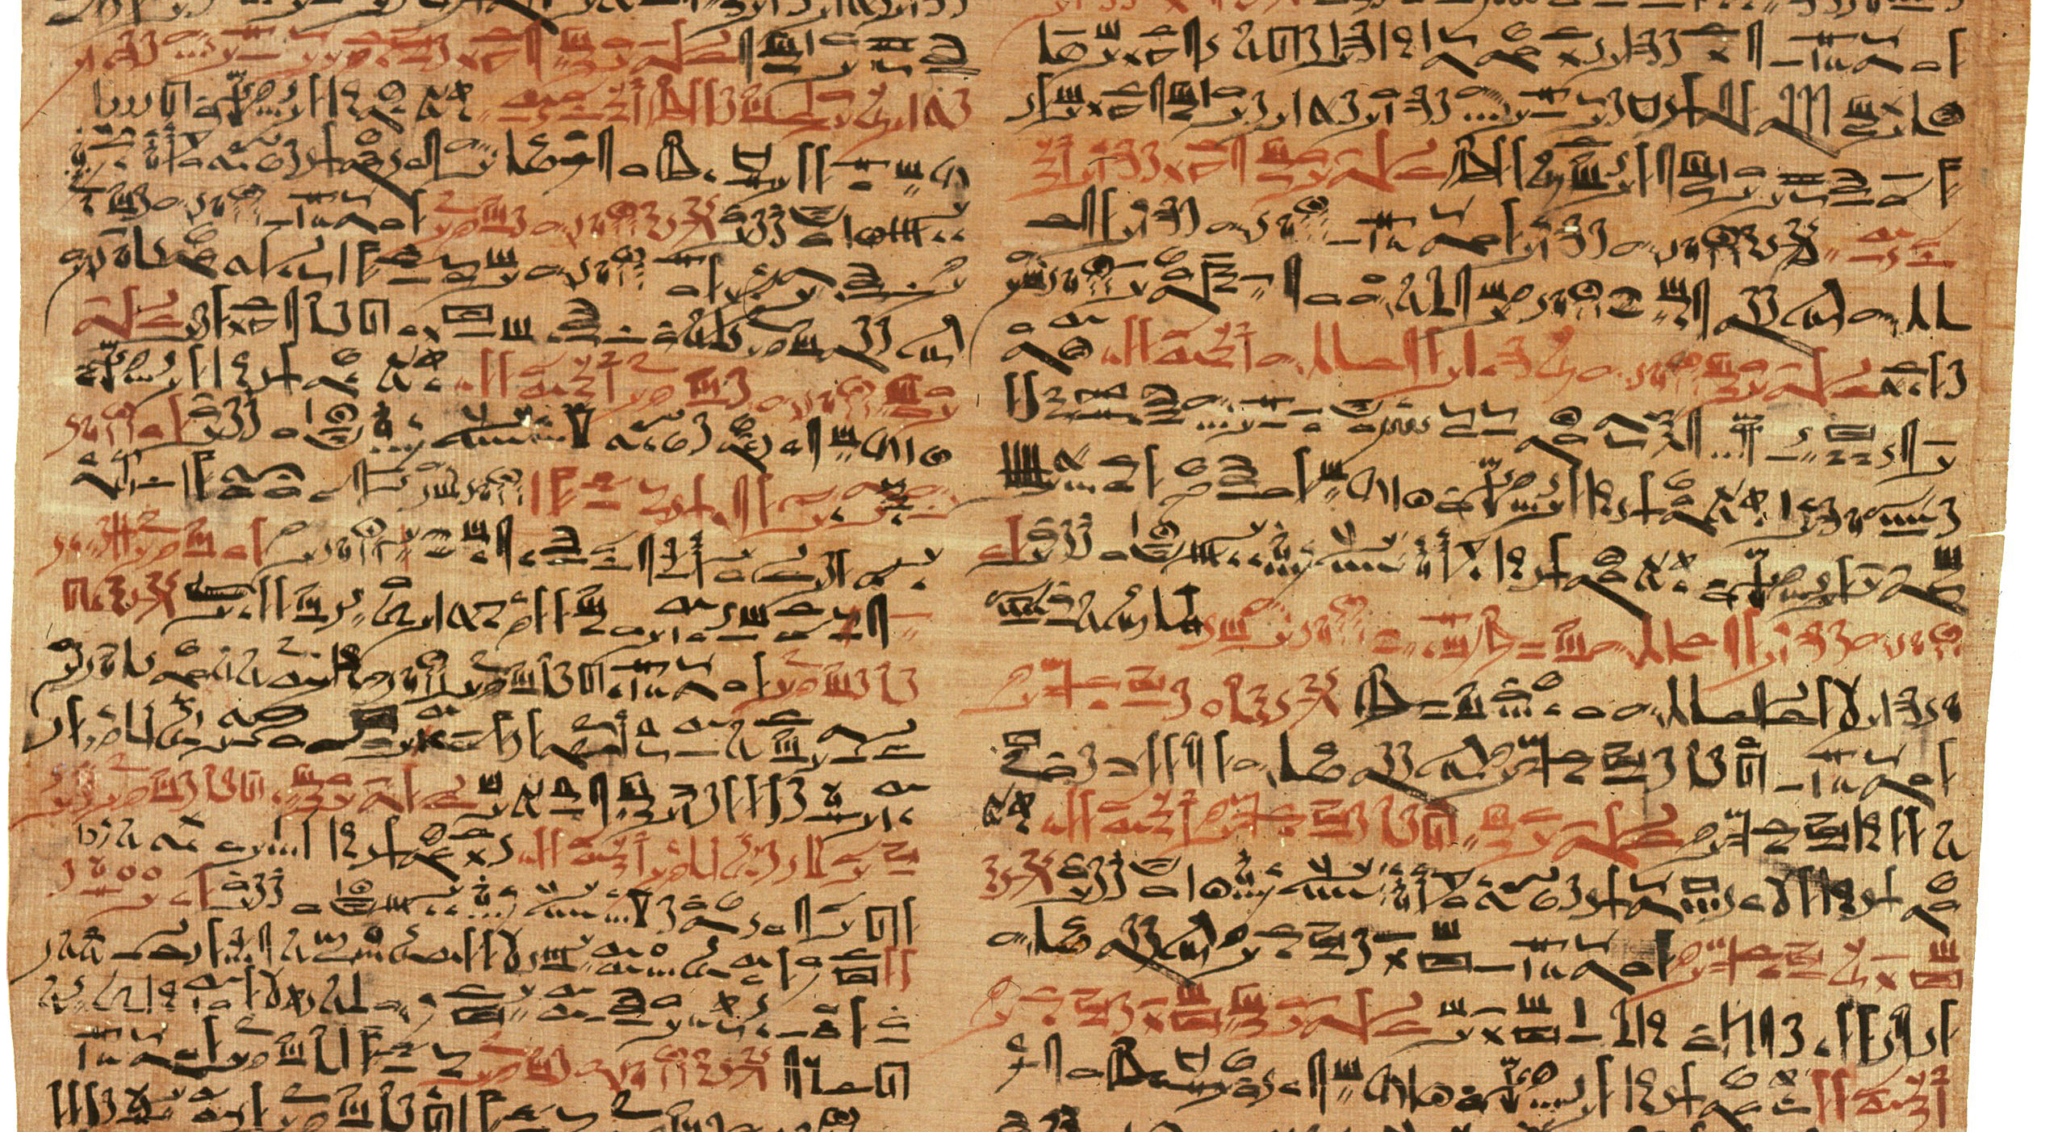
The Words of the Ancients

Slide 19
The Words of the Ancients
RFC 4035
If the resolver does not support any of the algorithms listed in an authenticated DS RRset, then the resolver will not be able to verify the authentication path to the child zone. In this case, the resolver SHOULD treat the child zone as if it were unsigned.

Slide 20
DNS resolver failure modes for an unknown signing algorithm
If a DNSSEC-Validating resolver receives a response DS with an unknown crypto algorithm does it:
  Immediately stop resolution and return a status code of SERVFAIL?
  Fetch the DNSKEY RR and then return a status code of SERVFAIL?
  Abandon validation and just return the unvalidated query result?

Slide 21
Hmmm
How does this relate to affected users?
How do validating resolvers manage an unrecognised algorithm failure?
Lets try again and look at both DNS query and web log data

Slide 22
Second Approach to answering the ECC question – DNS + WEB
Data collection: 2/3/15 – 19/3/15
1,830,668 clients who appear to be exclusively using RSA DNSSEC-Validating resolvers
ECC Results:
Success: 79.9% 1,461,772 Saw fetches of the ECC DNSSEC RRs and the well-
signed named URL, but not the badly signed named URL
Failure (fetched both URLs):
Mixed Resolvers 5.1% 93,746 Used both ECDSA-Validating and non-validating resolvers
NO ECC 13.3% 243,794 Saw A, DS, no DNSKEY, fetched both URLs
Mixed 1.3% 24,420 Saw some DNSSEC queries, fetched both URLs
No Validation 0.4% 6,836 Did not fetch any DNSSEC RRs
Apparent Fail: 20.1% 368,796
1 in 5 clients that use resolvers that perform DNSSEC validation with RSA fail to validate with ECDSA

Slide 23
Results
These results show that 80% of clients who appeared to exclusively use RSA DNSSEC-Validating resolvers were also seen to perform validation using ECDSA
Two thirds of the the remaining clients fetched both objects (13% of the total), but did not fetch any DNSKEY RRs.
Of the remainder (5%), most were using a validating resolver (which returned SERVFAIL for the badly signed object), and then the client failed over to a non-validating resolver *
* This is curious, because these clients did not failover to a non-validating resolver on a badly signed RSA structure

Slide 24
Where?
ECDSA failure rates – the % of users in each country who use RSA DNSSEC validating resolvers,
but fail to validate when the DNSSEC crypto algorithm is ECDSA. Top 24 countries, ranked by
Observed ECC Validation failure rates
Rank CC Failure Samples Country Name
1 CY 94.1% 5,638 Cyprus
2 MT 92.3% 1,973 Malta
3 BB 92.0% 1,402 Barbados
4 GE 84.4% 5,478 Georgia
5 ZA 81.6% 4,618 South Africa
6 KE 76.4% 2,377 Kenya
7 MN 75.6% 1,412 Mongolia
8 AU 73.4% 5,785 Australia
9 FI 72.7% 5,137 Finland
10 LU 71.3% 1,027 Luxembourg
11 YE 62.9% 2,524 Yemen
12 BA 60.1% 11,910 Bosnia and Herzegovina
13 BY 59.4% 10,574 Belarus
14 SI 55.7% 16,587 Slovenia
15 MK 51.8% 3,722 The former Yugoslav Republic of Macedonia
16 AM 51.4% 3,235 Armenia
17 TN 50.9% 4,241 Tunisia
18 PS 46.6% 11,255 Occupied Palestinian Territory
19 IQ 42.2% 20,469 Iraq
20 LT 41.1% 2,544 Lithuania
21 CA 40.3% 13,633 Canada
22 GT 38.0% 3,007 Guatemala
23 JP 36.9% 12,149 Japan
24 NO 36.6% 3,625 Norway
25 CZ 35.8% 26,813 Czech Republic

Slide 25
Which AS?
ECDSA failure rates – the % of users in each AS who use RSA DNSSEC validating resolvers, but fail to validate when the DNSSEC crypto algorithm is ECDSA – top 25 Ases ranked by ECC failure rate
AS Fail Rate Samples AS Description
1 7155 100.0% 887 WB-DEN2 - Viasat Communications Inc.,US
2 44143 99.7% 1,225 VIPMOBILE-AS Vip mobile d.o.o.,RS
3 12644 98.6% 2,418 TELEMACH Telemach Autonomous System,SI
4 7679 98.5% 583 QTNET Kyushu Telecommunication Network Co.,Inc.,JP
5 28926 98.4% 501 DONTELE-AS Telenet LLC,UA
6 4804 98.2% 4,030 MPX-AS Microplex PTY LTD,AU
7 27813 98.2% 3,915 Teledifusora S.A.,AR
8 198589 98.1% 1,334 JT-AS Al-Jazeera Al-Arabiya Internet LTD,IQ
9 16232 97.9% 2,419 ASN-TIM TIM (Telecom Italia Mobile) Autonomous System,IT
10 34797 97.8% 4,585 SYSTEM-NET System Net Ltd,GE
11 23700 97.2% 7,931 FASTNET-AS-ID Linknet-Fastnet ASN,ID
12 15735 97.1% 1,873 DATASTREAM-NET GO p.l.c.,MT
13 6407 96.9% 785 PRIMUS-AS6407 - Primus Telecommunications Canada Inc.,CA
14 37457 96.5% 2,924 Telkom-Internet,ZA
15 5603 96.3% 6,178 SIOL-NET Telekom Slovenije d.d.,SI
16 11815 96.2% 967 Cooperativa Telefonica de V.G.G. Ltda.,AR
17 7992 96.1% 3,651 COGECOWAVE - Cogeco Cable,CA
18 43132 96.1% 589 KBT-AS OJSC Rostelecom,RU
19 21310 95.8% 550 ASN-SATELLITE ISP Satellite,UA
20 6866 95.6% 7,067 CYTA-NETWORK Cyprus Telecommunications Authority,CY
21 41557 95.4% 809 TELEKABEL-AS Trgovsko kablovska televizija ROBI DOOEL Stip,MK
22 34449 95.4% 563 MORDOVIA-AS OJSC Rostelecom,RU
23 8473 94.9% 859 BAHNHOF Bahnhof Internet AB,SE
24 262928 94.5% 635 DIRECTV COLOMBIA,CO
25 29695 94.3% 981 LYSE-AS Altibox AS,NO

Slide 26
Which Resolver?
Most intensively used RSA-validating resolvers that appear to lack support for ECDSA
Rank Resolver Use AS AS Description
1 83.66.2.163 13,415 12978 DOGAN-ONLINE DOGAN TV DIGITAL PLATFORM ISLETMECILIGI A.S.,TR
2 202.73.99.4 10,905 23700 FASTNET-AS-ID Linknet-Fastnet ASN,ID
3 59.108.128.141 10,229 4847 CNIX-AP China Networks Inter-Exchange,CN
4 211.136.115.194 9,840 24400 CMNET-V4SHANGHAI-AS-AP Shanghai Mobile Communications Co.,Ltd.,CN
5 211.136.115.198 9,208 24400 CMNET-V4SHANGHAI-AS-AP Shanghai Mobile Communications Co.,Ltd.,CN
6 181.48.0.231 8,801 14080 Telmex Colombia S.A.,CO
7 4.31.99.79 8,457 3356 LEVEL3 - Level 3 Communications, Inc.,US
8 165.254.103.209 7,747 2914 NTT-COMMUNICATIONS-2914 - NTT America, Inc.,US
9 4.53.108.207 7,605 3356 LEVEL3 - Level 3 Communications, Inc.,US
10 212.73.224.143 7,413 3356 LEVEL3 - Level 3 Communications, Inc.,US
11 182.48.200.3 7,386 45769 DVOIS-IN D-Vois Broadband Pvt Ltd,IN
12 4.31.99.81 7,053 3356 LEVEL3 - Level 3 Communications, Inc.,US
13 4.53.108.209 7,021 3356 LEVEL3 - Level 3 Communications, Inc.,US
14 181.48.0.232 6,854 14080 Telmex Colombia S.A.,CO
15 186.130.130.21 6,839 22927 Telefonica de Argentina,AR
16 206.183.111.4 6,595 33480 WEBWERKSAS1 - Web Werks,US
17 165.254.103.207 6,555 2914 NTT-COMMUNICATIONS-2914 - NTT America, Inc.,US
18 189.124.128.172 6,399 28220 CABO SERVICOS DE TELECOMUNICACOES LTDA,BR
19 202.73.97.42 6,139 23700 FASTNET-AS-ID Linknet-Fastnet ASN,ID
20 202.73.97.44 5,790 23700 FASTNET-AS-ID Linknet-Fastnet ASN,ID
21 4.31.108.209 5,735 3356 LEVEL3 - Level 3 Communications, Inc.,US
22 124.161.87.93 5,477 4837 CHINA169-BACKBONE CNCGROUP China169 Backbone,CN
23 4.31.108.207 5,372 3356 LEVEL3 - Level 3 Communications, Inc.,US
24 103.15.63.4 5,180 59164 APOLLOONLINE-AS Apollo Online Services Pvt ltd,IN
25 218.29.129.3 5,124 4837 CHINA169-BACKBONE CNCGROUP China169 Backbone,CN

Slide 27
Why?
These resolvers all generate queries for the A record and the DS record, but did not query for the DNSKEY record when the signing algorithm was ECDSA
It appears that these resolvers who do not perform the DNSKEY query do not have local support for ECDSA
  Resolvers do not, in general use a custom crypto library
  As we saw with the Heartbleed bug, there is a preponderance of use of OpenSSL
  So perhaps the question is: why doesn’t OpenSSL support ECDSA?

Slide 28
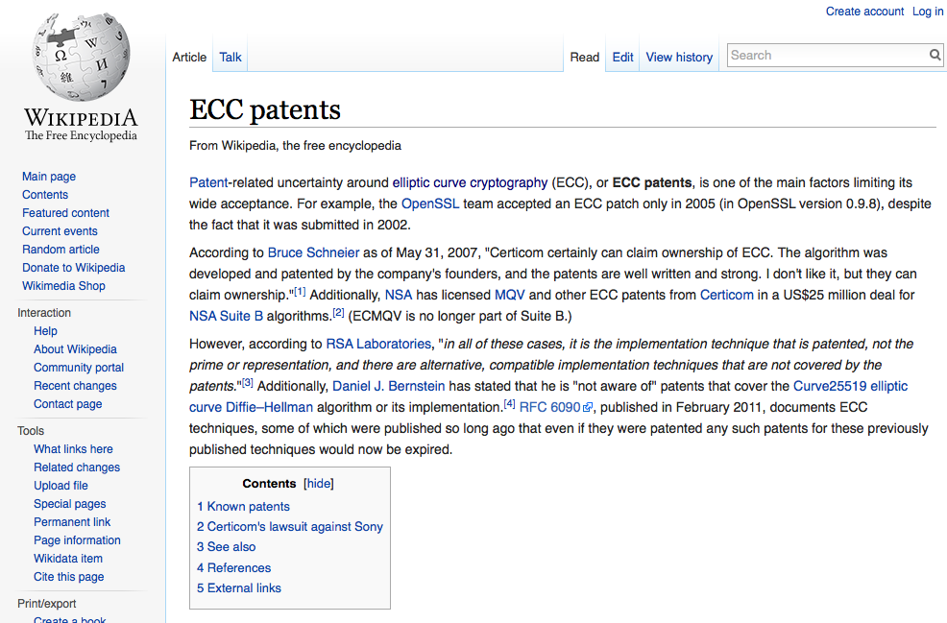

Slide 29
Why?
OpenSSL added ECDSA support as from 0.9.8
Other bundles and specific builds added ECDSA support later
But deployed systems often lag behind the latest bundles, and therefore still do not include ECC support in their running configuration

Slide 30
Is ECDSA a viable crypto algorithm for DNSSEC?
If the aim is to detect efforts to compromise the DNS for the signed zone, then signing a zone with ECDSA limits the number of DNS resolvers who will validate the signature
Which is a shame, because the shorter key lengths could be attractive for DNS over UDP

Slide 31
ECDSA in the (semi-)wild
$ dig +dnssec www.cloudflare-dnssec-auth.com
; <<>> DiG 9.9.6-P1 <<>> +dnssec www.cloudflare-dnssec-auth.com
;; global options: +cmd
;; Got answer:
;; ->>HEADER<<- opcode: QUERY, status: NOERROR, id: 7049
;; flags: qr rd ra ad; QUERY: 1, ANSWER: 6, AUTHORITY: 0, ADDITIONAL: 1
;; OPT PSEUDOSECTION:
; EDNS: version: 0, flags: do; udp: 4096
;; QUESTION SECTION:
;www.cloudflare-dnssec-auth.com. IN A
;; ANSWER SECTION:
www.cloudflare-dnssec-auth.com. 300 IN A 104.20.23.140
www.cloudflare-dnssec-auth.com. 300 IN A 104.20.21.140
www.cloudflare-dnssec-auth.com. 300 IN A 104.20.19.140
www.cloudflare-dnssec-auth.com. 300 IN A 104.20.22.140
www.cloudflare-dnssec-auth.com. 300 IN A 104.20.20.140
www.cloudflare-dnssec-auth.com. 300 IN RRSIG A 13 3 300 20150317021923 20150315001923 35273 cloudflare-dnssec-auth.com. pgBvfQkU4Il8ted2hGL9o8NspvKksDT8/jvQ+4o4h4tGmAX0fDBEoorb tLiW7mcdOWYLoOnjovzYh3Q0Odu0Xw==
;; Query time: 237 msec
;; SERVER: 127.0.0.1#53(127.0.0.1)
;; WHEN: Mon Mar 16 01:19:24 UTC 2015
;; MSG SIZE rcvd: 261

Slide 32
Thanks!

